Slide 1
Slope One Predictors for Online Rating-Based Collaborative Filtering Daniel Lemire , Anna Maclachlan
報告者：610721204 陳克威
日 期：2018/12/20
Notes:
協同過濾的推薦系統
於2005年發表

Slide 2
Outline
Introduction
Related Work
CF Algorithms
Slope One
Experimental results
Conclusions

Slide 3
Introduction

Slide 4
Introduction
Rating-based collaborative filtering is the process of predicting how a user would rate a given item from other user ratings.
We aim to provide robust CF schemes that are :
(1) easy to implement and maintain
(2) updateable on the fly
(3) efficient at query time
(4) expect little from first visitors
(5) accurate within reason
Notes:
利用其他人的rating來預測你的rating。
作者的目標不是要比較各種CF算法的準確性，而是要證明Slope One方案同時滿足所有五個目標。
(1)容易實現與維護
(2)用戶新增一個Rating後，應該立即改變所有預測結果。
(3) 查詢速度要快。
(4)對於新的用戶也要能給予有效的推薦。
(5)即使這個算法很簡單，但與其他最好的算法相比，精確度不會輸太多。

Slide 5
Related Work

Slide 6
Related Work
Memory-based collaborative filtering uses a similarity measure between pairs of users to build a prediction, typically through a weighted average.
Some potential drawbacks of memory-based CF include scalability and sensitivity to data sparseness.
In general, schemes that rely on similarities across users cannot be precomputed for fast online queries.
Notes:
Memory-based 透過計算用戶之間的相似度來做預測。
缺點：擴展性、數據稀疏性
通常不能線上快速計算與查詢

Slide 7
Related Work
Our predictors are of the form f(x) = x + b, hence the name “slope one”.
We use naïve predictors of the form f(x) = x + b. We also use naïve weighting.
其他人提出： f(x) = ax + b. 、 f(x) = ax2 + bx + c
Even their regression-based f(x) = ax + b algorithm didn’t lead to large improvements over memory-based algorithms.
Notes:
即使是基於回歸的算法也沒有導致算法的大幅改進。

Slide 8
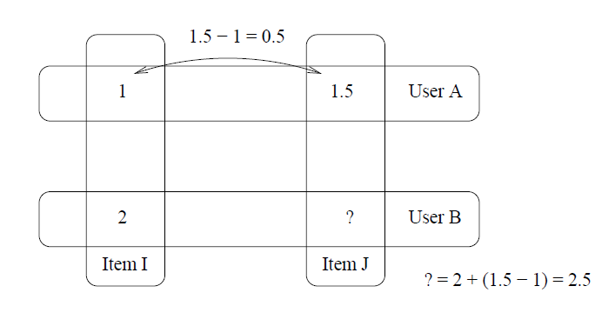
Related Work

Slide 9
CF Algorithms

Slide 10
CF Algorithms
We propose three new CF schemes, and contrast our proposed schemes with four reference schemes:
(1)PER USER AVERAGE
(2)BIAS FROM MEAN
(3)ADJUSTED COSINE ITEM-BASED
(4)PEARSON scheme
Notes:
(1-2)model-based scheme. (查詢速度較快)
(3-4)memory-based schemes.

Slide 11
CF Algorithms
Evaluation : The ratings from a given user
ui : The rating of this user gives to item i
S(u) : The subset of the set of items consisting of all those items which are rated in u
χ : The set of all evaluations in the training set
card(S) : The number of elements in a set S
¯u : The average of ratings in an evaluation u

Slide 12
CF Algorithms
One of the most basic prediction algorithms is the PER USER AVERAGE scheme given by the equation
P(u) = u¯. That is, we predict that a user will rate everything according to that user’s average rating.
Notes:
User會用自己的平均值去預測其他物品

Slide 13

CF Algorithms
BIAS FROM MEAN
Notes:
右：其他人對物品i的評分-他自己的平均值
下：是有多少人對物品i評分

Slide 14

CF Algorithms
ADJUSTED COSINE ITEM-BASED
Notes:
改進的余弦相似度 (item-based)
分母要開根號會比較好？
分子 : u對i評分 – u自己的平均
分母 : u對i評分 – u自己的平均

Slide 15

CF Algorithms
ADJUSTED COSINE ITEM-BASED
Notes:
α,β 回歸係數(regression coefficients)
I,J的相似度 * User對J的評分

Slide 16

CF Algorithms
The PEARSON Reference Scheme
γ is a similarity measure computed from Pearson’s correlation.
Notes:
上：兩個用戶 U,V的相似度 * v對i的評分-v自己的平均
下：除以 u跟v的相似度

Slide 17

CF Algorithms
The PEARSON Reference Scheme
Notes:
計算兩個User的相似度：他們一起評分過的物品。
上：U給的評分-自己的平均 * W給的評分-自己的平均 (相乘)
下：(U給的評分-自己的平均)平方後相加 * (W給的評分-自己的平均)平方後相加

Slide 18


CF Algorithms
The PEARSON Reference Scheme
with ρ = 2.5, where ρ is the Case Amplification power.
${\text{Corr}\text{(0.9)}}^{2.5}$ = 0.8
${\text{Corr}\text{(0.1)}}^{2.5}$ -> 0.003
Notes:
設定2.5 reduce noise 可以減少 noise

Slide 19
Slope One

Slide 20


Slope One
The SLOPE ONE Scheme:
where Rj = {i|i ∈ S(u),i != j,card(Sj,i(χ)) > 0} is the set of all relevant items.
Notes:
Deviation (偏差)
其中 Sj,i() 表示同時對item i 和 j 給予了評分的用戶集合，
其中 Rj 表示所有用户 u 已经给予评分且满足条件 (i≠j 且 Sj,i非空) 的item集合。

Slide 21
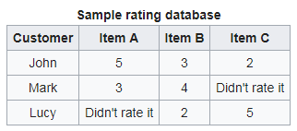
Slope One
Lucy :
2+[(5-3)+(3-4)]/2 = 2.5
5+(5-2) = 8
(2.5+8) / 2 = 5.25

Slide 22

Slope One
簡化版本 :

Slide 23
Slope One
Lucy :
Lucy平均 : (2+5)/2 = 3.5
Dev A,B = 0.5
Dev A,C = 3
3.5 + (0.5+3) / 2 = 5.25

Slide 24

Slope One
The WEIGHTED SLOPE ONE Scheme:
where cj,i = card(Sj,i(χ)).
Notes:
簡單來說，(C)他會把rating的人數也考慮進來。

Slide 25

Slope One
Lucy :

Slide 26

Slope One
The BI-POLAR SLOPE ONE Scheme:
Notes:
將user分成 喜歡/不喜歡物品
作者說這看起來會減少總評分數，
但是未能過濾掉不相關的評分可能更成問題。

Slide 27

Slope One
The BI-POLAR SLOPE ONE Scheme:
Notes:
物品也能分成兩類
User同時喜歡I,j 就把他考慮進來
User同時不喜歡I,j 就把他考慮進來

Slide 28

Slope One
The BI-POLAR SLOPE ONE Scheme:
Notes:
Deviation(偏差)

Slide 29
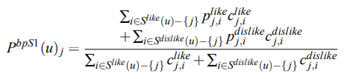
Slope One
The BI-POLAR SLOPE ONE Scheme:
where the weights c like j,i = card(S like j,i ) and c dislike j,i = card(S dislike j,i )
Notes:
這就跟前面weight版本一樣，只是like跟dislike拆開來算。
C代表weight 、數量

Slide 30
Experimental results

Slide 31

Experimental results
Mean Average Error (MAE)
where u (i) is user evaluation u with that user’s rating of the ith item, ui , hidden.
Notes:
一種他們用來算Error Rate的公式
他會隱藏User對Item的評價

Slide 32
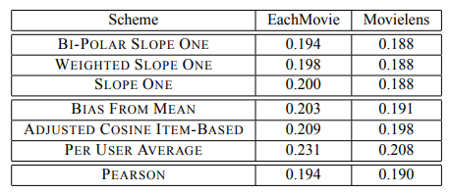
Experimental results
Notes:
lower is better.
0.0~1.0分、1~5分，他們有一些倍數的關係，將兩個combine在一起比較。
(1)正如他們所預測，BIAS FROM MEAN 是三種model-based裡面最好的。
(2)SLOPE ONE > BIAS FROM MEAN
(3)與PEARSON相比，即使簡單，但也相當準確。

Slide 33
Conclusions

Slide 34
Conclusions
Slope One schemes are easy to implement, dynamically updateable, efficient at query time, and expect little from first visitors while having a comparable accuracy (e.g. 1.90 vs. 1.88 MAE for MovieLens) to other commonly reported schemes.
This is remarkable given the relative complexity of the memory-based scheme under comparison.
A further innovation of our approach are that splitting ratings into dislike and like subsets can be an effective technique for improving accuracy.
Notes:
(1)簡單實作、動態更新、有效快速查詢、rating很少時也能用、準確度能達到不錯的效果
(2)複雜度相對低很多
(3)提出將ratings分成 like 與 dislike 可以提高準確性

Slide 35
Thanks for listening.
報告者：610721204 陳克威
日 期：2018/12/20

